Slide 1
CST 202 :Computer Organization and Architecture

Slide 2

Course Outcome

Slide 3
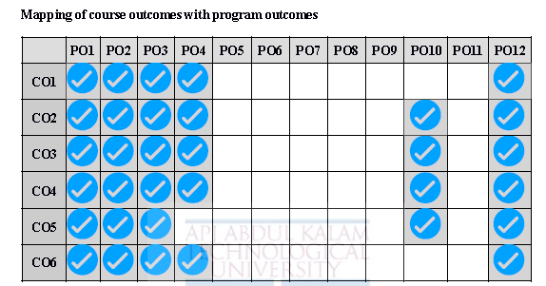
Mapping of course outcomes with program outcomes

Slide 4
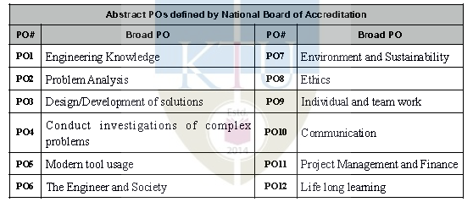
Abstract POs defined by National Board of Accreditation

Slide 5
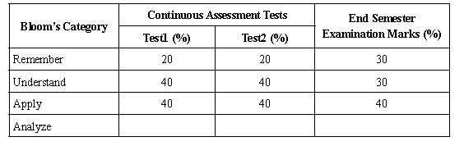
Assessment Pattern

Slide 6
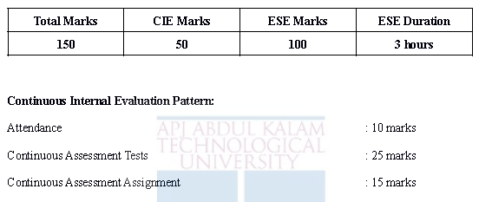
Mark Distribution

Slide 7

Textbook

Slide 8
SYLLABUS
Module 3
Arithmetic algorithms: Algorithms for multiplication and division (restoring method) of binary
numbers. Array multiplier , Booth’s multiplication algorithm.
Pipelining: Basic principles, classification of pipeline processors, instruction and arithmetic
pipelines (Design examples not required), hazard detection and resolution.

Slide 9
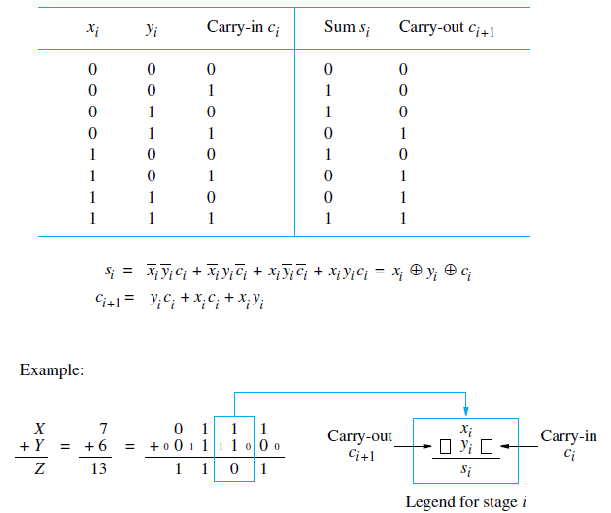
Addition and Subtraction of Signed Numbers

Slide 10
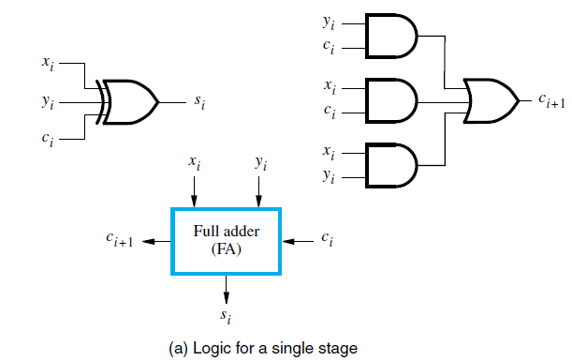
Addition and Subtraction of Signed Numbers

Slide 11
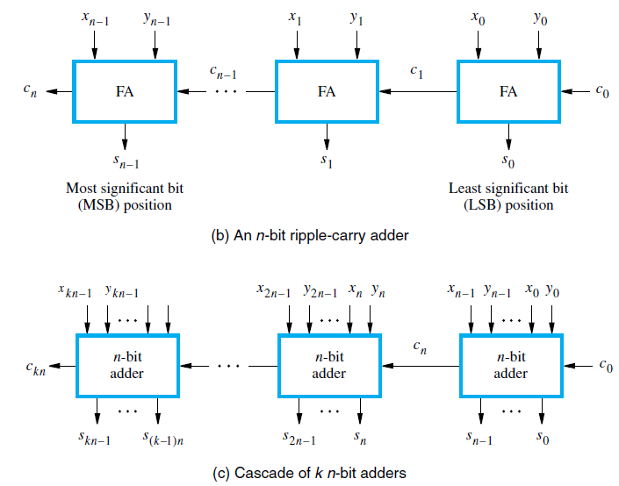
Addition and Subtraction of Signed Numbers

Slide 12
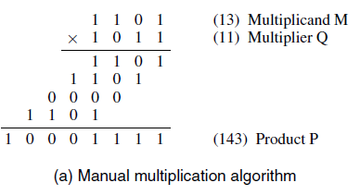
Multiplication of Unsigned Numbers
The product of two, unsigned, n-digit numbers can be accommodated in 2n digits
so the product of the two 4-bit numbers in this example is accommodated in 8 bits, as shown
Binary multiplication of unsigned operands can be implemented in a combinational, two dimensional, logic array
Partial products

Slide 13
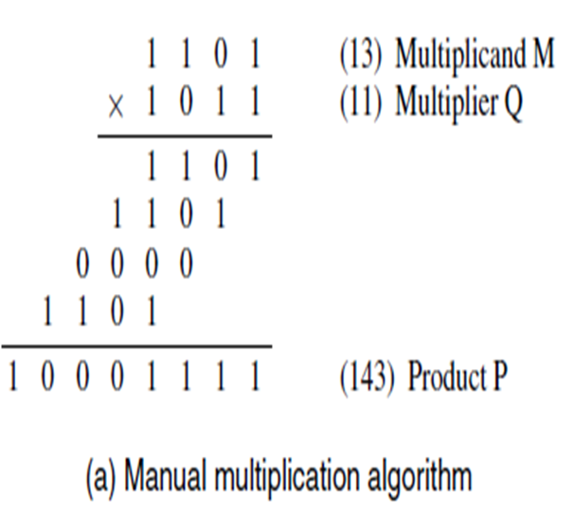

Unsigned multiplication can be viewed as addition of shifted versions of the multiplicand.
Multiplication involves the generation of partial products, one for each digit in the multiplier.
These partial products are then summed to produce the final product.
When the multiplier bit is 0, the partial product is 0.
When the multiplier is 1 the partial product is the multiplicand.
The total product is produced by summing the partial products.
For this operation, each successive partial product is shifted one position to the left relative to the preceding partial product.

Slide 14
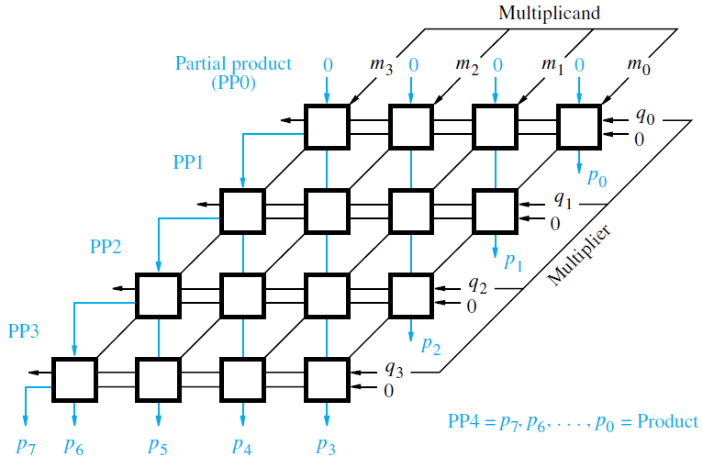
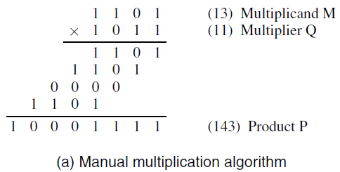
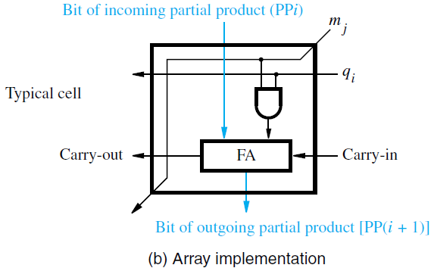
Array Multiplier

Slide 15
Array Multiplier
Binary multiplication of unsigned operands can be implemented in a combinational, two dimensional, logic array
The main component in each cell is a full adder, FA.
The AND gate in each cell determines whether a multiplicand bit, m_{j} , is added to the incoming partial-product bit, based on the value of the multiplier bit, q_{i} .
Each row i, where 0 ≤ i ≤ 3, adds the multiplicand (appropriately shifted) to the incoming partial product, PPi, to generate the outgoing partial product, PP(i + 1), if q_{i} = 1. If q_{i} = 0, PPi is passed vertically downward unchanged. PP0 is all 0s, and PP4 is the desired product.
The multiplicand is shifted left one position per row by the diagonal signal path.
We note that the row-by-row addition done in the array circuit differs from the usual hand addition, which is done column-by-column.

Slide 16
(a)Array multiplication of positive binary operands

Slide 17
The worst-case signal propagation delay path is from the upper right corner of the array to the high-order product bit output at the bottom left corner of the array.
This critical path consists of the staircase pattern that includes the two cells at the right end of each row, followed by all the cells in the bottom row.
Assuming that there are two gate delays from the inputs to the outputs of a full-adder block, FA, the critical path has a total of 6(n − 1) − 1 gate delays, including the initial AND gate delay in all cells, for an n × n array.
In the first row of the array, no full adders are needed, because the incoming partial product PP0 is zero.
This has been taken into account in developing the delay expression.

Slide 18
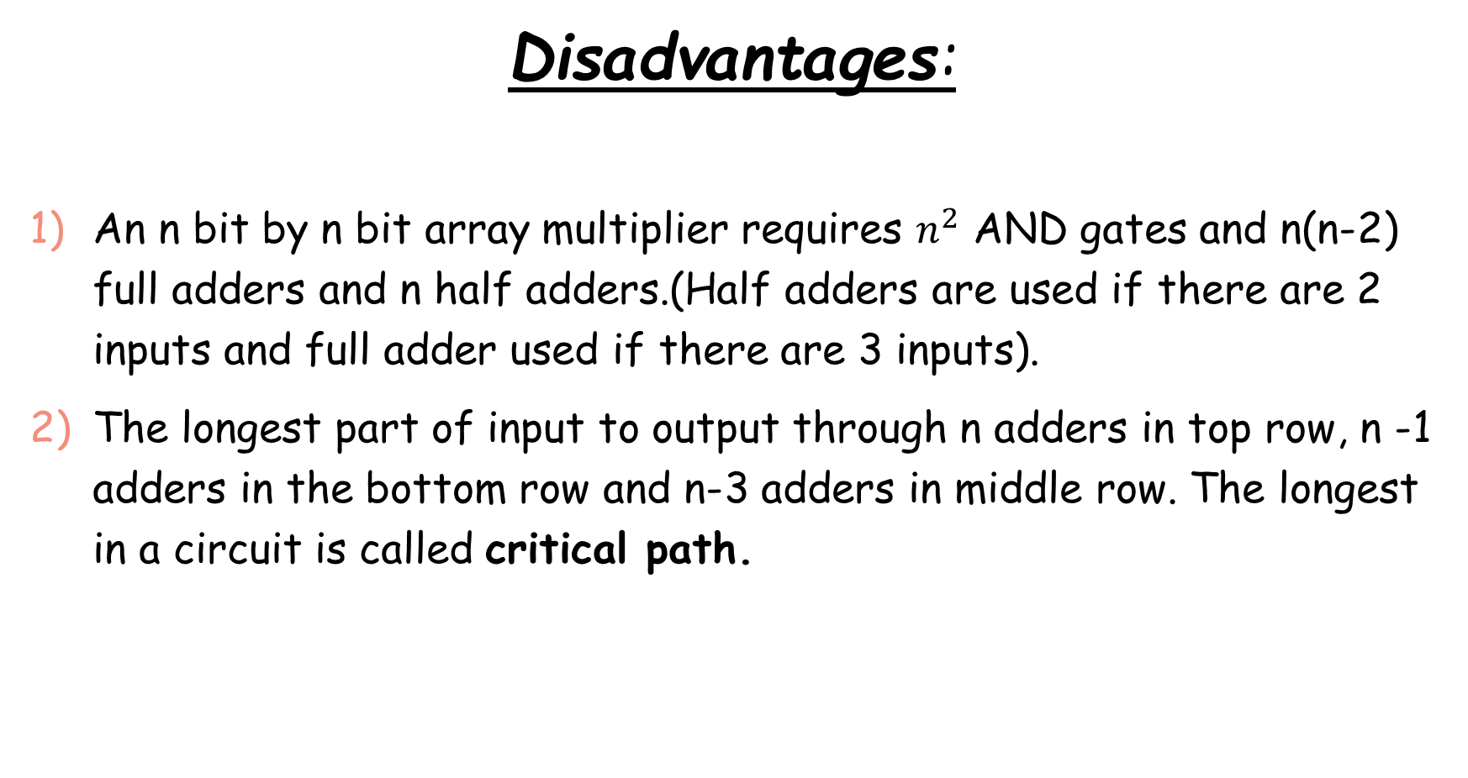
Disadvantages:
An n bit by n bit array multiplier requires $n^{2}$ AND gates and n(n-2) full adders and n half adders.(Half adders are used if there are 2 inputs and full adder used if there are 3 inputs).
The longest part of input to output through n adders in top row, n -1 adders in the bottom row and n-3 adders in middle row. The longest in a circuit is called critical path.

Slide 19
Sequential Circuit Multiplier
The combinational array multiplier uses a large number of logic gates for multiplying numbers of practical size, such as 32- or 64-bit numbers.
Multiplication of two n-bit numbers can also be performed in a sequential circuit that uses a single n-bit adder.
This circuit performs multiplication by using a single n-bit adder n times to implement the spatial addition performed by the n rows of ripple-carry adders

Slide 20
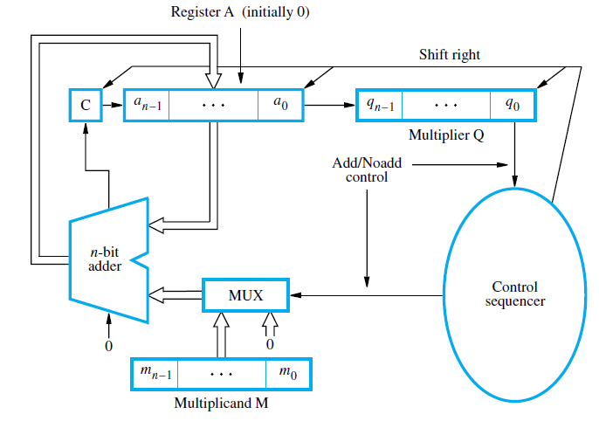
Sequential Circuit Multiplier

Slide 21
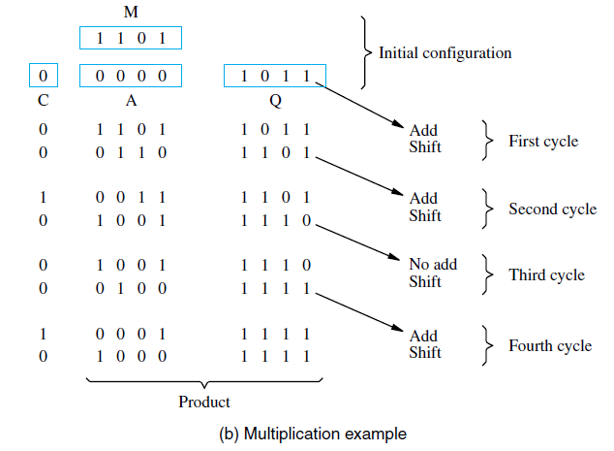
Sequential Circuit Multiplier

Slide 22
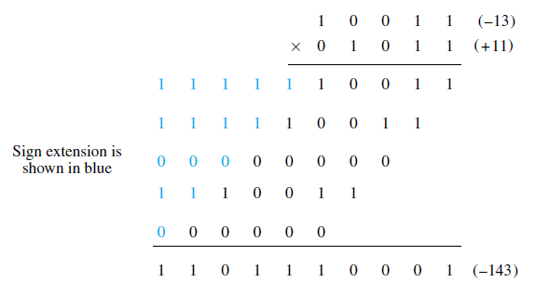
Multiplication of Signed Numbers
Consider the case of a positive multiplier and a negative multiplicand.
When we add a negative multiplicand to a partial product, we must extend the sign-bit value of the multiplicand to the left as far as the product will extend.
Figure shows an example in which a 5- bit signed operand, −13, is the multiplicand. It is multiplied by +11 to get the 10-bit product, −143.
The sign extension of the multiplicand is shown in blue.

Slide 23
Multiplication of Signed Numbers
For a negative multiplier, a straightforward solution is to form the 2’s-complement of both the multiplier and the multiplicand and proceed as in the case of a positive multiplier.
This is possible because complementation of both operands does not change the value or the sign of the product.
A technique that works equally well for both negative and positive multipliers, called the Booth algorithm

Slide 24
Booth algorithm
The Booth algorithm generates a 2n-bit product and treats both positive and negative 2’scomplement n-bit operands uniformly.
To understand the basis of this algorithm, consider a multiplication operation in which the multiplier is positive and has a single block of 1s, for example, 0011110.
To derive the product, we could add four appropriately shifted versions of the multiplicand, as in the standard procedure.
For convenience, we can describe the sequence of required operations by recoding the preceding multiplier as 0 +1 0 0 0 −1 0.→ Booth Reading
-1 for 0→1 transition and
+1 for 1→ 0 transition
0 for no changes in transitions

Slide 25
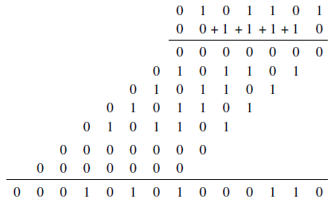
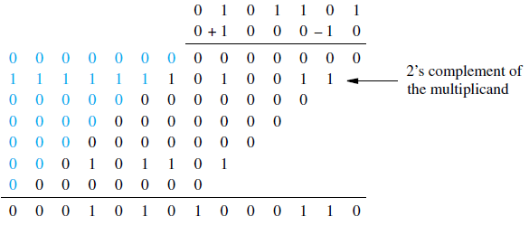
Normal and Booth multiplication schemes
Features of Booth Algorithm:
Booth algorithm works equally well for both negative and positive multipliers.
Booth algorithm deals with signed multiplication of given number.
Speed up the multiplication process.

Slide 26
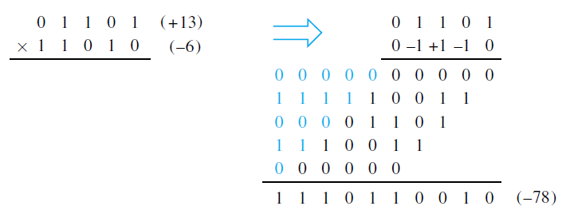
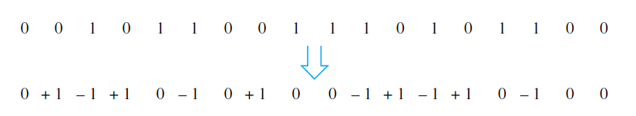
Booth multiplication with a negative multiplier

Slide 27
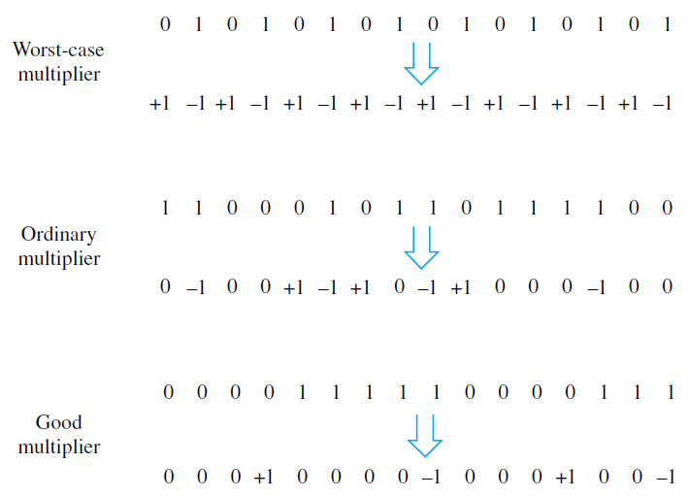
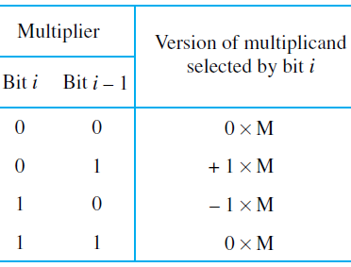
Booth Recording of a Multiplier:

Slide 28
Booth Recording of a Multiplier:
In worst case multiplier, numbers of addition and subtraction operations are large.
In ordinary multiplier, 0 indicates no operation, but still there are addition and subtraction operations to be performed.
In good multiplier, booth algorithm works well because majority are 0s .
A good multiplier consists of block/sequence of 1s.

Slide 29
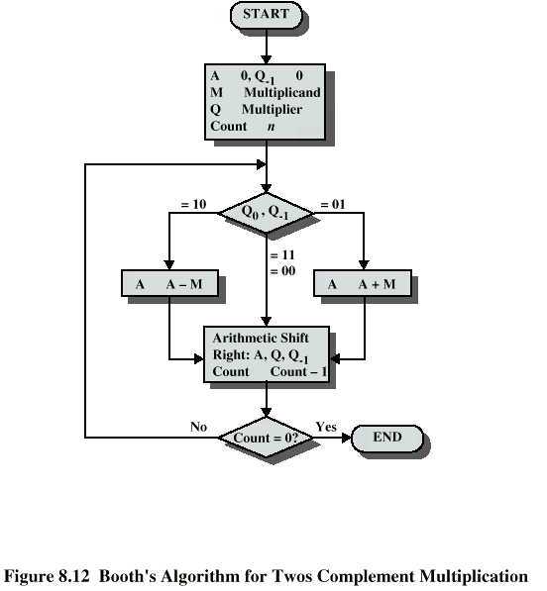
Algorithm
Multiplicand is placed in M and Multiplier in Q
Accumulator register A, Q₋₁ are initialized to 0
Sequence counter Count is initialized to n (number of bits).
Compare Q₀ and Q₋₁ and perform the following
01→A=A+M
10 →A=A-M → A= A+M’+1
00 → No arithmetic operation
11→ No arithmetic operation
ASHR- Arithmetic Shift right A,Q, Q₋₁
Decrement Count by 1
Repeat till Count =0
The final product will be store in AC, QR

Slide 30
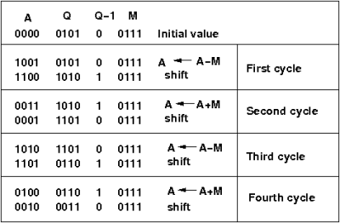
7*5

Slide 31
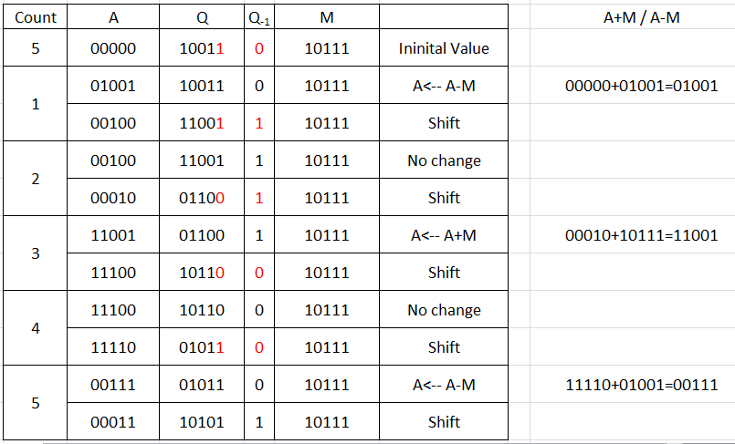

-9 x -13

Slide 32
Division
(Restoring Method)
CST 202 : Computer Organization
& Architecture

Slide 33
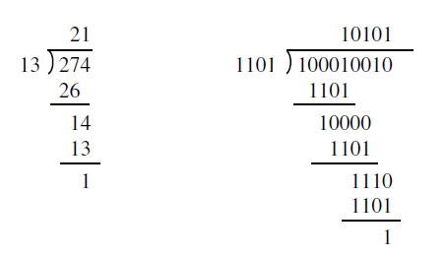
Longhand division examples

Slide 34
Division
A circuit that implements division by this longhand method operates as follows:
It positions the divisor appropriately with respect to the dividend and performs a subtraction.
If the remainder is zero or positive, a quotient bit of 1 is determined, the remainder is extended by another bit of the dividend, the divisor is repositioned, and another subtraction is performed.
If the remainder is negative, a quotient bit of 0 is determined, the dividend is restored by adding back the divisor, and the divisor is repositioned for another subtraction.
This is called the restoring division algorithm.

Slide 35
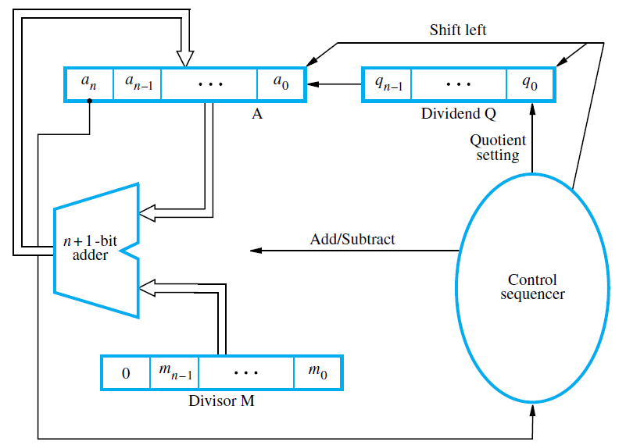

Slide 36
Shift A and Q left one bit position.
Subtract M from A, and place the answer back in A.
If the sign of A is 1, set q0 to 0 and add M back to A (that is, restore A); otherwise, set q0 to 1.

Slide 37
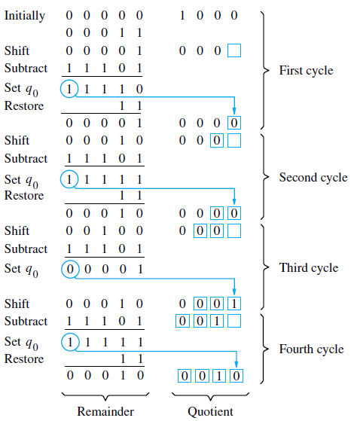
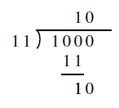

Slide 38
Module 3
Pipelining – basic principles
CST 202 : Computer Organization
& Architecture

Slide 39
Pipelining- Basic Principles
Pipelining is a method to realize, overlapped parallelism in the proposed solution of a problem, on a digital computer in an economical way.
Pipelining is the method to introduce temporal parallelism in computer operations.
A pipeline processor may process each instruction in 4 steps:
F Fetch: Read the instruction from the memory
D Decode: Decode the instruction and fetch the source operands
E Execute: Perform the operation specified by the instruction
M Memory Access: In case if the instruction demands
W Write: Store the result in the destination location.

Slide 40
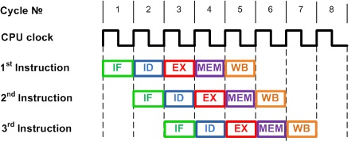
Instruction Fetch (IF)
Instruction Decode (ID)
Execute (EX)
Memory Access (MEM)
Writeback (WB)

Slide 41
Performance Improvement
In order to properly identify the performance improvement that can be achieved using the pipelining technique, we need to use two terms – latency and throughput.
Latency is the time it takes for an operation to complete.
Throughput is the number of operations that are completed in a certain time frame.
We can conclude with previous diagram
The pipeline does not affect the latency. The instruction cycle consisting of 5 phases is the same whether pipelining is used or not. Each instruction takes 5 clock cycles to complete.
The pipeline improves the throughput, with potential speedup equal to the number of pipeline stages.
Once the pipeline is filled and continuously fed, we can have an instruction completed on every clock cycle (Cycles Per Instruction (CPI) = 1). This is, of course, the ideal case not taking into account some of the pipeline limitations

Slide 42
Pipeline Limitations
There are some known limitations to pipelining technique used in microprocessors. Hazards prevent the next instruction in the pipeline to be executed in its designated clock cycle. The pipeline hazards can be grouped into three categories:
Data Hazard – Can occur when an instruction depends on the result of a previous instruction still being processed in the pipeline.
Structural Hazard – Can occur when the available hardware does not support some instruction combinations.
Control Hazards – Caused by jump and branch instructions. These instructions will usually require the flushing (emptying) of the pipeline and loading it with instructions from addresses pointed by the branch and jump instructions.

Slide 43
Module 3
Classification of pipeline processors
CST 202 : Computer Organization
& Architecture

Slide 44
Pipelining- Classification
Various types of pipelining can be applied in computer operations depending on the following factors:
Level of Processing
Pipeline configuration
Type of Instruction and data

Slide 45
Classification according to level of processing
Instruction Pipeline:
An instruction cycle may consist of many operations like, fetch opcode, decode opcode, compute operand addresses, fetch operands, and execute instructions.
These operations of the instruction execution cycle can be realized through the pipelining concept.
Each of these operations forms one stage of a pipeline.
The overlapping of execution of the operations through the pipeline provides a speedup over the normal execution.
Thus, the pipelines used for instruction cycle operations are known as instruction pipelines.

Slide 46
Classification according to level of processing
Arithmetic Pipeline:
The complex arithmetic operations like multiplication, and floating point operations consume much of the time of the ALU.
These operations can also be pipelined by segmenting the operations of the ALU and as a consequence, high speed performance may be achieved.
Thus, the pipelines used for arithmetic operations are known as arithmetic pipelines.

Slide 47
Classification according to pipeline configuration:
Uni-function Pipelines: When a fixed and dedicated function is performed through a pipeline, it is called a Uni-function pipeline.
Multifunction Pipelines: When different functions at different times are performed through the pipeline, this is known as Multifunction pipeline.
Multifunction pipelines are reconfigurable at different times according to the operation being performed.

Slide 48
Classification according to type of instruction and data:
Scalar Pipelines: This type of pipeline processes scalar operands of repeated scalar instructions.
Vector Pipelines: This type of pipeline processes vector instructions over vector operands.

Slide 49
Module 3
Instruction and arithmetic pipelines
CST 202 : Computer Organization
& Architecture

Slide 50
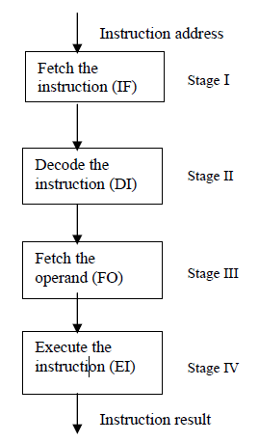
Instruction Pipelining
The stream of instructions in the instruction execution cycle, can be realized through a pipeline where overlapped execution of different operations are performed.
The process of executing the instruction involves the following major steps:
• Fetch the instruction from the main memory
• Decode the instruction
• Fetch the operand
• Execute the decoded instruction
The pipeline is executing the instruction in an overlapped manner increasing the throughput and speed of execution.

Slide 51
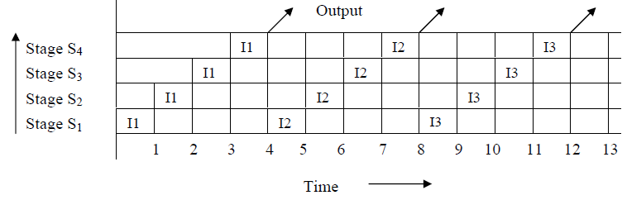
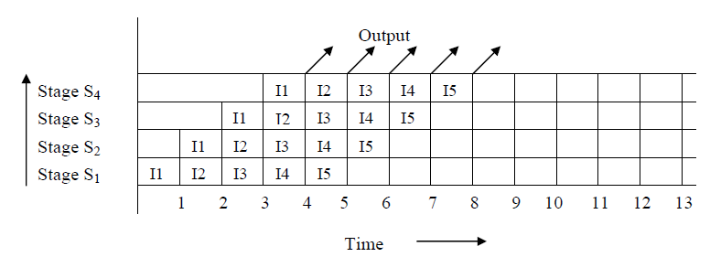
Non-pipelined Processor vs. Overlapped Instruction pipelined Processor

Slide 52
Instruction Buffers
For taking the full advantage of pipelining, pipelines should be filled continuously.
Therefore, instruction fetch rate should be matched with the pipeline consumption rate. To do this, instruction buffers are used.
Instruction buffers in CPU have high speed memory for storing the instructions.
The instructions are pre-fetched in the buffer from the main memory.
Another alternative for the instruction buffer is the cache memory between the CPU and the main memory.
The advantage of cache memory is that it can be used for both instruction and data.
But cache requires more complex control logic than the instruction buffer.

Slide 53
Arithmetic Pipelining
The technique of pipelining can be applied to various complex and slow arithmetic operations to speed up the processing time. And are called Arithmetic pipelines.
Arithmetic pipelines are constructed for simple fixed-point and complex floating-point arithmetic operations.
These arithmetic operations are well suited to pipelining as these operations can be efficiently partitioned into subtasks for the pipeline stages.
For implementing the arithmetic pipelines we generally use following two types of adder:
Carry propagation adder (CPA): It adds two numbers such that carries generated in successive digits are propagated.
Carry save adder (CSA): It adds two numbers such that carries generated are not propagated rather these are saved in a carry vector

Slide 54
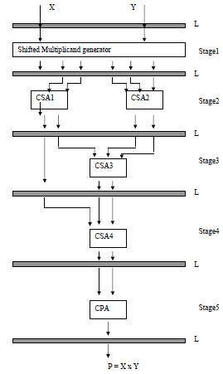
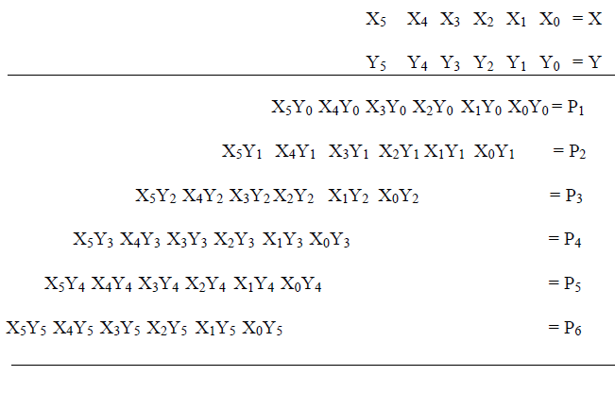
Fixed Arithmetic Pipelining- example of multiplication

Slide 55
Fixed Arithmetic Pipelining- example of multiplication
The first stage generates the partial product of the numbers, which form the six rows of shifted multiplicands.
In the second stage, the six numbers are given to the two CSAs merging into four numbers.
In the third stage, there is a single CSA merging the numbers into 3 numbers.
In the fourth stage, there is a single number merging three numbers into 2 numbers.
In the fifth stage, the last two numbers are added through a CPA to get the final product.

Slide 56
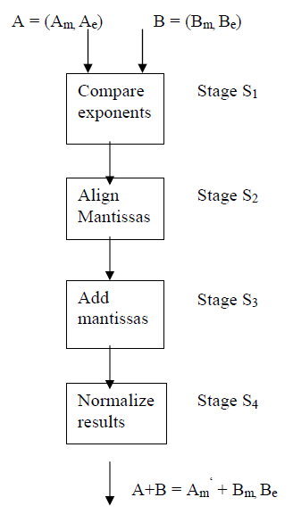
Floating point Arithmetic pipelines
Floating point computations are the best candidates for pipelining.
Consider example of addition of two floating point numbers.
Following stages are identified for the addition of two floating point numbers:
First stage will compare the exponents of the two numbers.
Second stage will look for alignment of mantissas.
In the third stage, mantissas are added.
In the last stage, the result is normalized.

Slide 57
Module 3
hazard detection and resolution
CST 202 : Computer Organization
& Architecture

Slide 58
PIPELINE CONFLICTS:
Resource Conflicts: They are caused by access to memory by two segments at the same time. Most of these conflicts can be resolved by using separate instruction and data memories.
Data Dependency: these conflicts arise when an instruction depends on the result of a previous instruction, but this result is not yet available.
Branch Difference: they arise from branch and other instructions that change the value of PC.
When one of the pipeline stage is not able to complete its processing task for a given instruction in the time allotted, the pipelined operation is said to have stalled.
Any condition that cause pipeline to stall is called a hazard.

Slide 59
Pipelining- Hazard Types
Data hazard: Any condition in which either the source or destination operands of an instruction are not available at the time expected in the pipeline.
As a result some operation has to be delayed and the pipeline stalls.
Control hazards or Instruction hazards: The pipeline may also be stalled because of a delay in the availability of an instruction.
For example, this may result a miss in the cache requiring the instruction to be fetched from the main memory.
Structural hazard occur when there is a situation when two instructions require the use of a given hardware resource at the same time.
Most common case is access to memory. One instruction may need to access memory as part of execute or write stage while the other is being fetched.

Slide 60
Pipelining- Hazard Detection and Resolution
Pipeline hazards are caused by resource usage conflicts among various instructions in the pipeline.
Such hazards are triggered by inter instruction dependencies when successive instructions overlap their fetch, decode and execution through a pipeline processor
Inter instruction dependencies may arise to prevent the sequential data flow in the pipeline.
For example an instruction may depend on the results of a previous instruction.
Until the completion of the previous instruction, the present instruction cannot be initiated into the pipeline.
In other instances, two stages of a pipeline may need to update the same memory location.
Hazards of this sort, if not properly detected and resolved could result in an inter lock situation in the pipeline or produce unreliable results by overwriting.

Slide 61
Pipelining- Hazard Detection and Resolution
There are three classes of data dependent hazards, according to various data update patterns:
Write After Read hazards (WAR) : may occur when J attempt to modify some data object that is read by I.
Read After Write hazards (RAW) : hazard between the two instructions I and J may occur when they attempt to read some data object that has been modified by I.
Write After Write hazards (WAW) : may occur if both I and J attempt to modify the same data object.
Read After Read does not pose a problem because nothing is changed

Slide 62
Pipelining- Hazard Detection and Resolution
We use Resource Object to refer to working registers, memory locations and special flags.
The contents of these resource objects are called data objects.
Each instruction can be considered a mapping from a set of data objects to a set of data objects.
The Domain D(I) of an instruction I is a set of resource objects whose data objects may affect the execution of instruction I.
The Range R(I) of an instruction is the set of resource objects whose data objects may be modified by the execution of instruction I.
Obviously, the operands to be used in an instruction execution are retrieved (read) from its domain and the results will be stored (written) in its range.

Slide 63
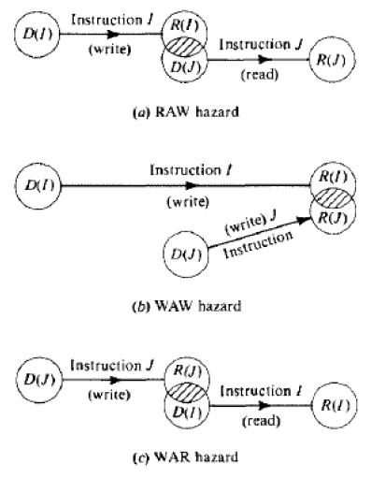

Pipelining- Hazard Detection and Resolution

Slide 64
Pipelining- Hazard Detection and Resolution
Once the hazard is detected, the system should resolve the interlock situation
A straightforward approach is to stop the pipe and to suspend the execution of the coming instructions until instruction I has passed the point of resource conflict.
A more sophisticated approach is to suspend only next instruction J and continue the flow of instruction down the pipe
Multi level hazard detection may be encountered, requiring more complex control mechanisms to resolve a stack of hazards

Slide 65
Pipelining- Hazard Detection and Resolution
In order to avoid RAW hazards, IBM engineers developed a short circuiting approach which gives a copy of the data object to be written directly to the instruction waiting to read the data.
This concept was generalized into a technique known as data forwarding, which forward multiple copies of the data to as many waiting instructions as may wish to read it.
A data forwarding chain can be established in some cases.
The internal forwarding and register-tagging techniques are helpful in resolving logic hazards in pipelines

